Slide 1
OS Structures 2 Design and Implementation
David Liu
Fall 2021

Slide 2
Learning Outcomes
Identify services provided by an OS
Illustrate how system calls are used to provide OS services
Understand OS design with goals and specifications
Understand design principles
Understand various ways of OS implementations

Slide 3
OS Design
Design Goals
Highest Design levels: hardware and system types
User goals
e.g. be convenient to use, easy to learn, reliable, safe, and fast
System goals
e.g. (a) be easy to design, implement, and maintain;
(b) flexible, reliable, error-free, and efficient

Slide 4
OS Design Principle
In general software design principle
Separation of policy from mechanisms
What: policy often changes
How: general mechanisms support various policies (flexibility)
Examples
Timer
Priority scheduling
Microkernel-based OS vs Microsoft Windows vs Apple macOS

Slide 5
Implementation
Language choices
Assembly languages
High level languages: C and C++ (easy port to other hardware)
A mix of languages
Assembly language in lowest levels
C for main body
C, C++, scripting lang. (Python), shell scripts

Slide 6
OS System Structure
Monolithic
Layered
Microkernel

Slide 7
Monolithic
All functionality of the kernel into
a single, static binary file
runs in a single address space
Difficult to implement
Performance advantage
Efficient system-call interface
Fast communication within kernel

Slide 8
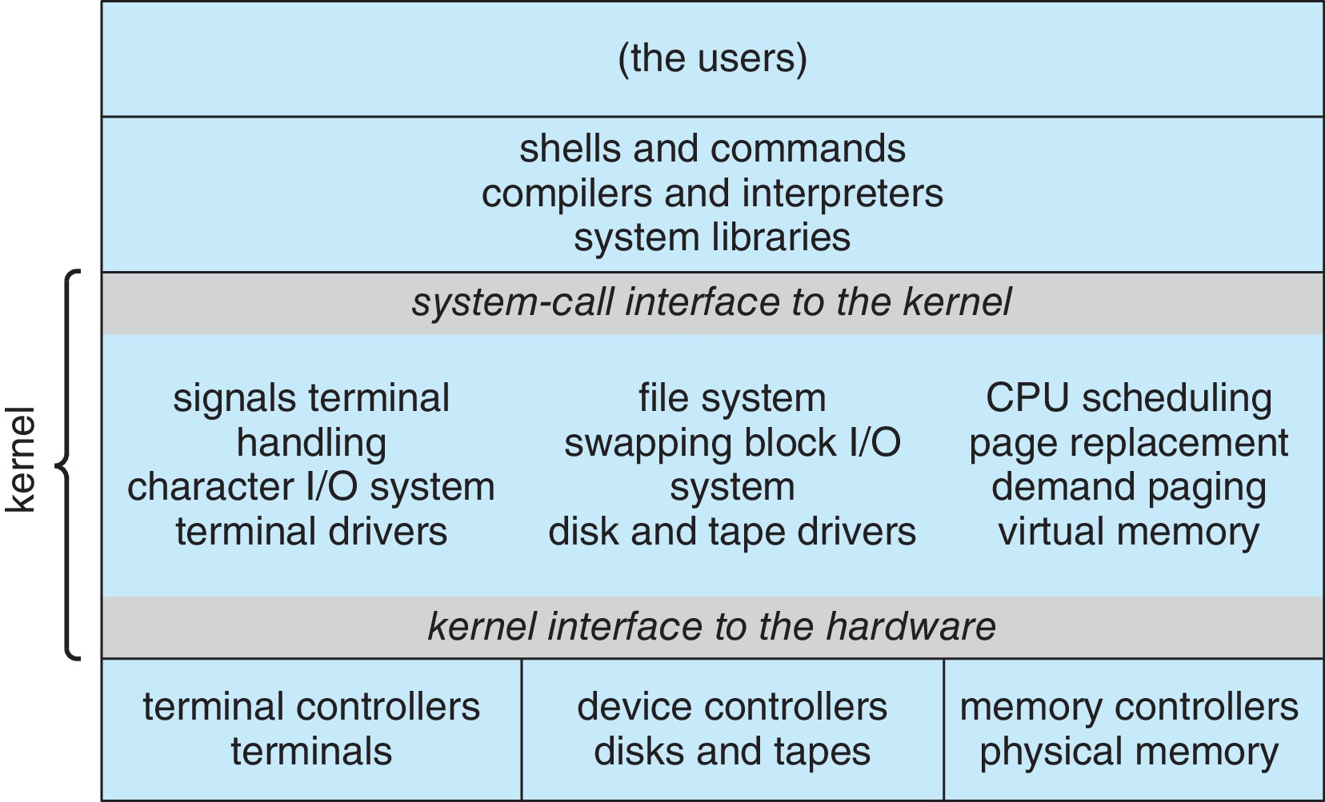
Monolithic OSes
Traditional UNIX

Slide 9
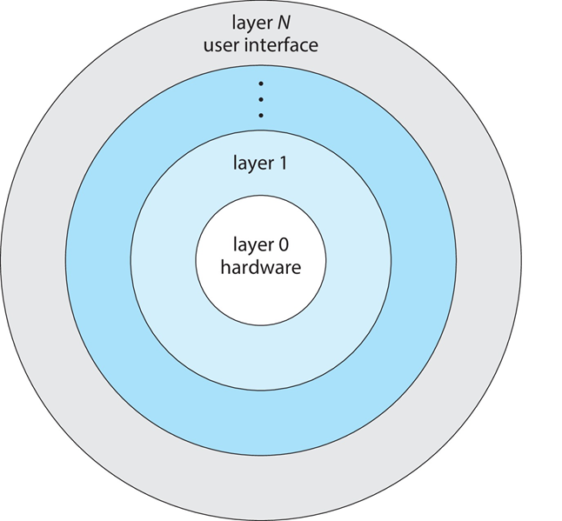
Layered Approach
Number of layers (levels)
Advantages: simplicity of constructing and debugging
Overhead to traverse layers

Slide 10
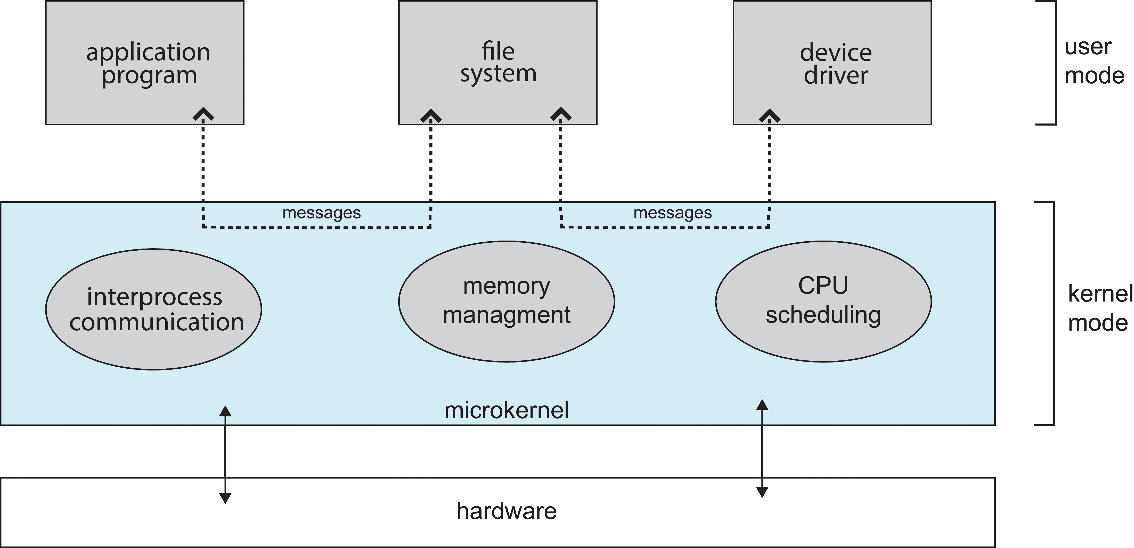
Microkernels
Small kernel
minimum process management
memory management
Communication facility

Slide 11
Microkernel
Advantages
Easy to port, secure, reliable
Performance issues
Copying messages
Switching between processes

Slide 12
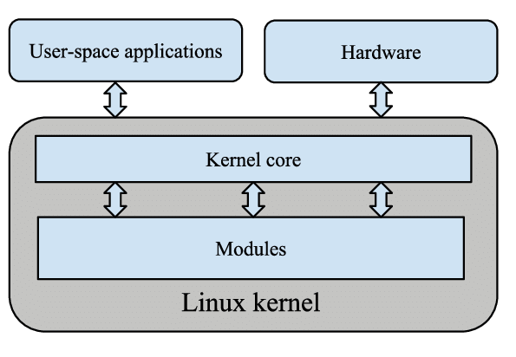
Modules
Kernel: core components
Loadable kernel modules (LKMs)
boot time
run time

Slide 13
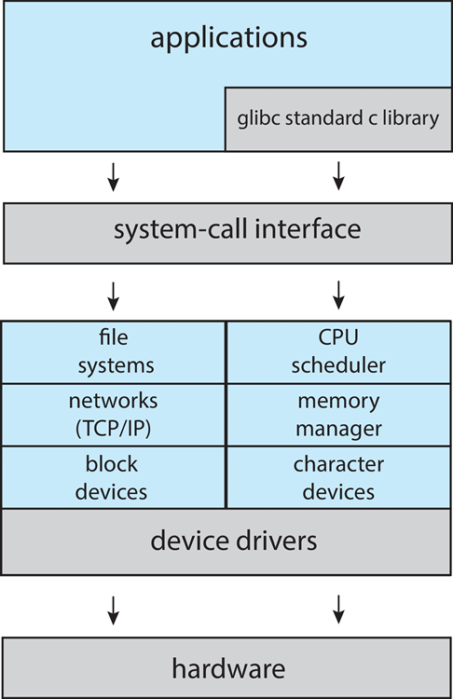
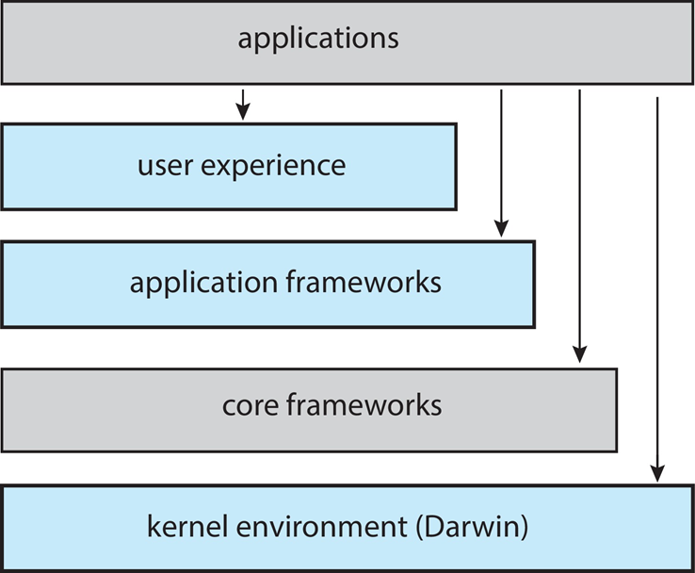
Hybrid: MacOS, LINUX
Layered & Modules
Linux
macOS / iOS

Slide 14
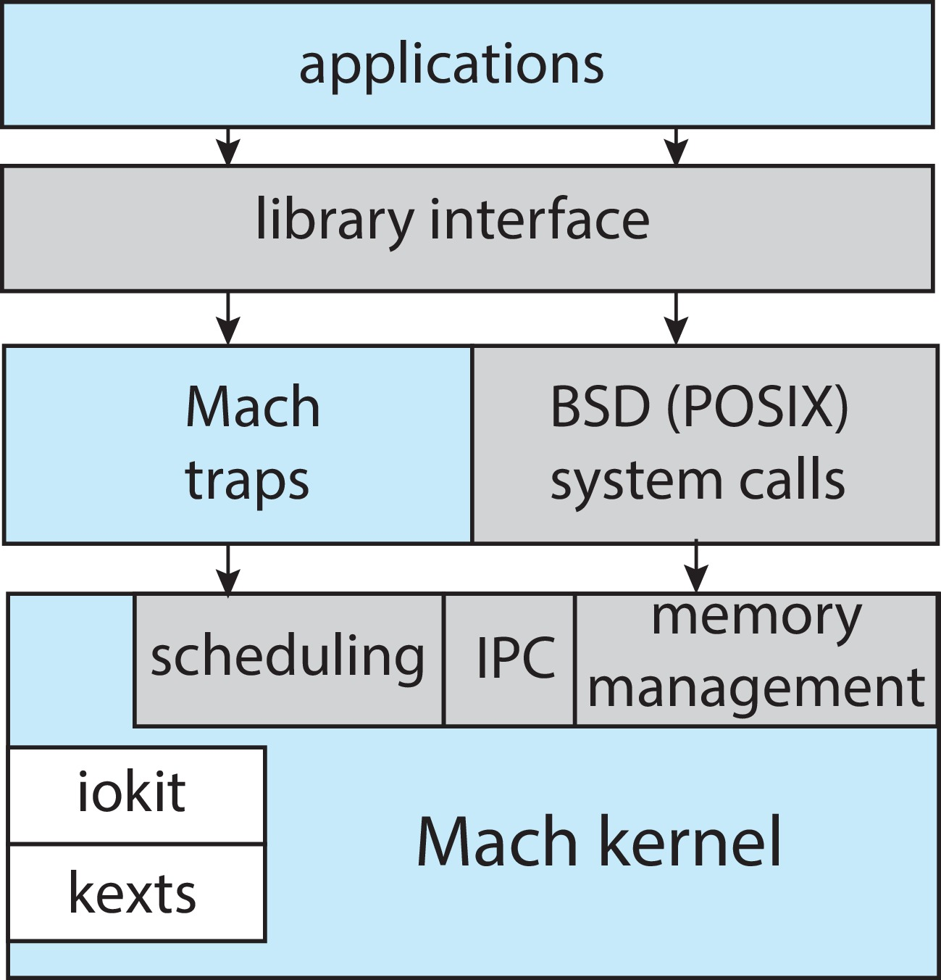
Hybrid: Darwin
MacOS and Darwin

Slide 15
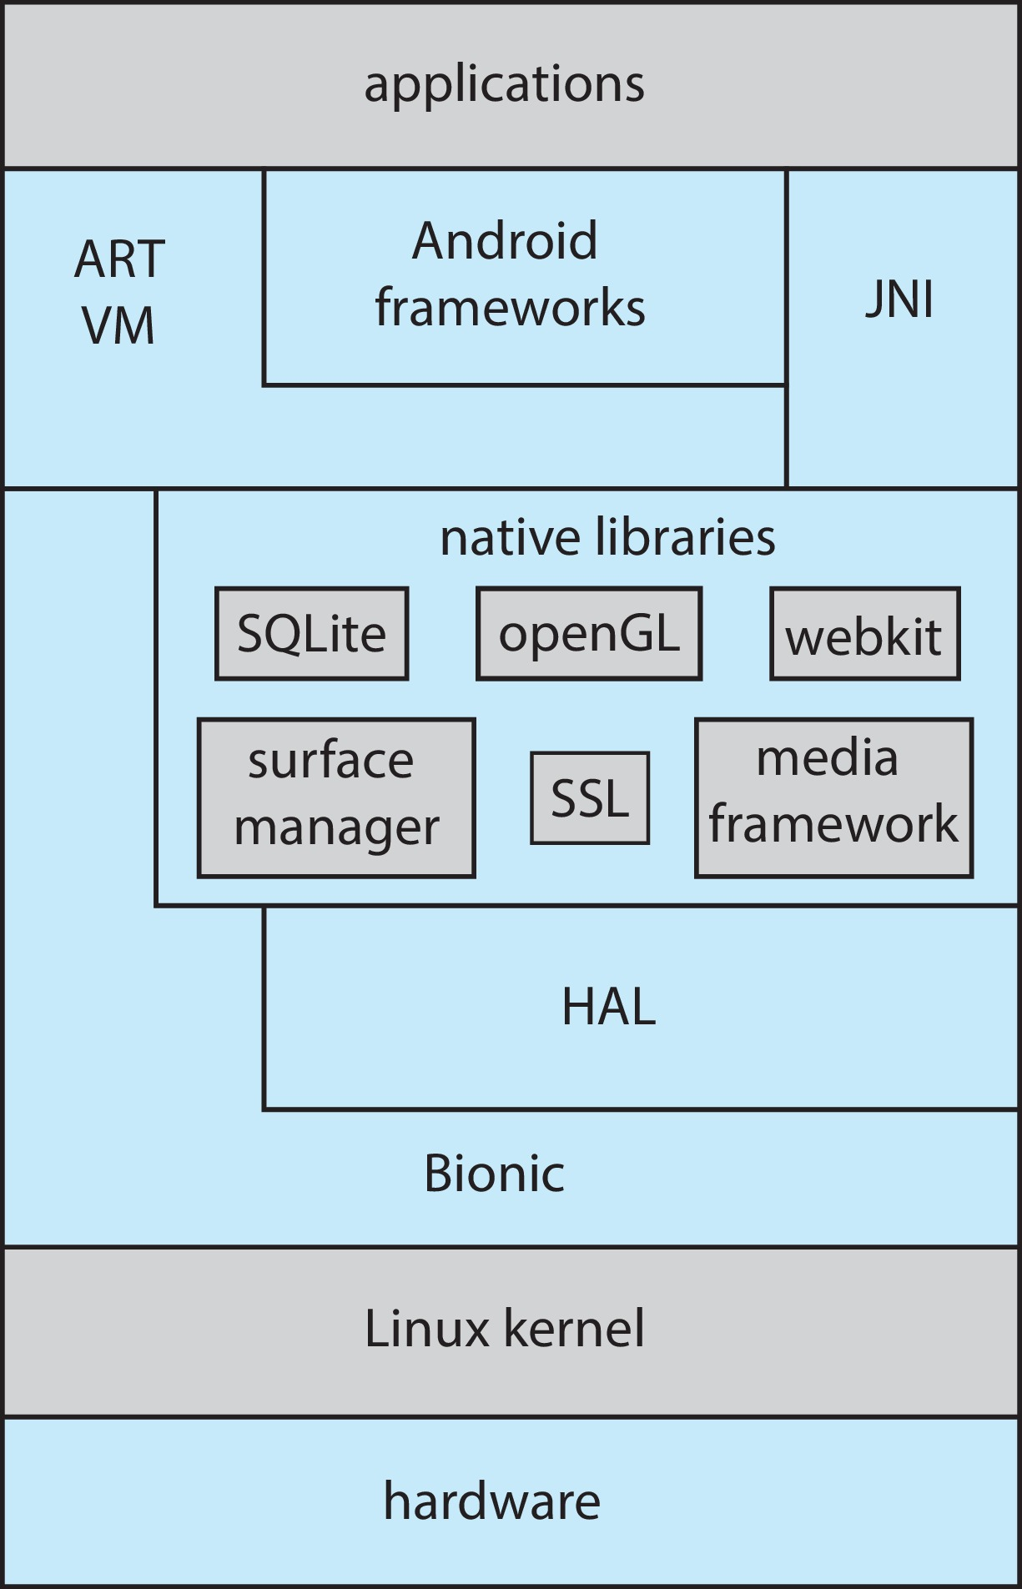
Hybrid: Android

Slide 16
Hybrid: iOS
Cocoa Touch Objective-C API for developing apps
Media services layer for graphics, audio, video
Core services provides cloud computing, databases
Core operating system, based on Mac OS X kernel

Slide 17
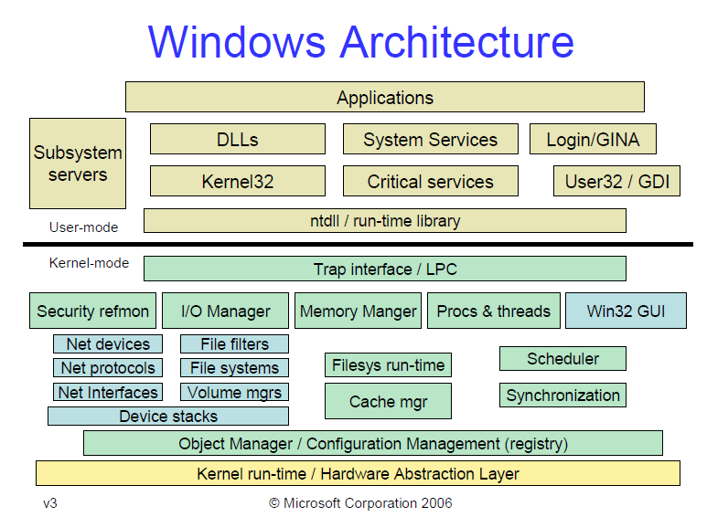
Hybrid: Windows

Slide 18
Windows Subsystem for Linux
Linux lets developers run a GNU/Linux environment
-- including most command-line tools, utilities, and applications -- directly on Windows, unmodified, without the overhead of a traditional virtual machine or dual boot setup.
https://docs.microsoft.com/en-us/windows/wsl/about

Slide 19
Building OS
Write the operating system source code
Configure the operating system for the system on which it will run
Compile the operating system
Install the operating system
Boot the computer and its new operating system

Slide 20
System Boot
CPU execute at a fixed memory location
Bootstrap loader (ROM or EEPROM) locates the kernel, load to memory
Kernel loads and system is running

Slide 21
OS Debugging
Log files
Core dump of memory for processes
Crash dump for kernel memory

Slide 22
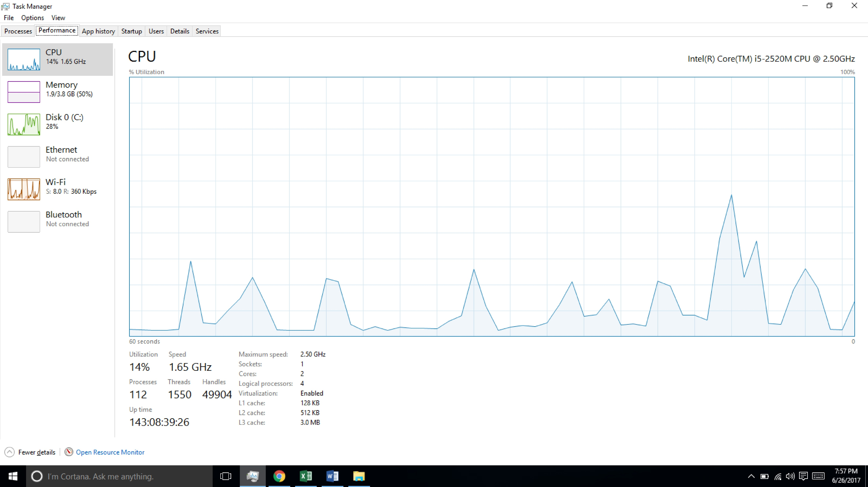
OS Performance Tuning
profiling
Windows 10 Task Manager

Slide 23
OS Performance Tuning
strace – trace system calls invoked by a process
gdb – source-level debugger
perf – collection of Linux performance tools
tcpdump – collects network packets

